Slide 1



Engineering Economics| ME 2001 | 3 Credits | 3 0 0 3
Engineering Economics
Course Outcomes
Understand various economic decision-making concepts applicable to engineering.
Estimate the present, annual and future worth, rate of return for various types of cash flows.
Evaluate uncertainty and risk analysis in future events.
Analyses for replacement analysis and break-even analysis.
Calculate depreciation and expenses.
Course Instructor Dr. Vijay S. Kumawat
Assistant Professor, Department of Mechanical Engineering
Engineered Biomedical Materials Research and Innovation Centre (EnBioMatRIC)
School of Automobile, Mechanical and Mechatronics Engineering (SAMME)
Manipal University Jaipur
Ph: +91-9001225135
Email: vijayshankar.Kumawat@jaipur.manipal.edu
: https://scholar.google.com/citations?user=3g9gCscAAAAJ&hl=en
: https://www.linkedin.com/in/vijay-shankar-kumawat-24a02a195
Website: https://www.jaipur.manipal.edu
https://www.enbionac.in/

Slide 2
Syllabus
Thesis Outline
Unit-1: Economic Decision Making
Overview, problems, role, decision making process.
Indian industries: introduction, pattern of industrialization, large scale industries
Labour problems and policies, unorganized sector.
Unit-2: Engineering Cost & Estimation
Fixed and Variable Costs
Marginal & Average Costs
Sunk Costs, Opportunity Costs
Recurring & Nonrecurring Costs
Incremental Costs, Cash Costs Vs Book Costs, Life- Cycle Costs
Types of Estimate, Estimating Models
Improvement & Learning Curve, Benefits
Economic Order Quantity
Unit-3: Uncertainty in Future Events
Estimates and their use in economic analysis
Economic decision tree
Risk, Risk vs Return.
Unit-4: Depreciation
Depreciation and expenses
Depreciation calculation fundamentals
Depreciation and capital allowance methods
Common elements of tax regulations for depreciation and capital allowances.
Unit 5: Replacement and forecasting Analysis
Replacement Analysis
Inflation and Price Change
Forecasting
Break Even Analysis

Slide 3
Study Material Resources
Thesis Outline
Text Books
T1. R. Panneerselvam, Engineering Economics, Prentice Hall of India.
T2. J.L. Riggs, D.D. Bedworth and S.U. Randhawa, Engineering Economics, McGraw Hill Education.
T3. P.L. Mehta, Managerial Economics, Sultan Chand & Sons.
Reference Books
R1. E.L. Grant, W.G. Ireson and R.S. Leavenworth, Principles of Engineering Economic Analysis, John Wiley.
R2. G,J. Tuesen, W.J. Fabrycky and H.G. Tuesen, Engineering Economy, Prentice Hall of India.
R3. L. Blank and A. Tarquin, Engineering Economy, McGraw Hill Education.

Slide 4
Assessment Rubrics
Thesis Outline
Criteria | Description | Maximum Marks
Internal Assessment (Summative) | Mid Term Examination | 30
 | Quizzes and Assignments, Activity feedbacks (CWS) | 30
End Term Exam (Summative) | End Term Examination | 40
Total |  | 100
Attendance (Formative) | A student must have maintained a 75% attendance rate in order to eligible for the End Term Examination. The 25 % allowance covers all leaves, not just medical ones.

Slide 5
Lecture Plan
Thesis Outline
L/T No. | Topics
L1 | Introduction to course, Read Course Handout and provide to the students
L2 | Economic Decision Making – Overview, Definition
L3 | Economic Decision Making – Problem and Role
L4 | Economic Decision Making – Indian Industries Introduction
L5 | Pattern of Industrialization, Large Scale Industries.
L6 | Labor Problems and Policies
L7 | Introduction to Unrecognized sector
L8 | Engineering Cost & Estimation - Introduction
L9 | Fixed, Variable, Marginal and Average Cost
L10 | Sunk Cost, Opportunity Cost
L11 | Recurring & Non Recurring Cost
L12 | Incremental Cost, Cash Cost Vs Book Costs
L13 | Life Cycle Costs
L14 | Types of Estimates - Introduction
L15 | Estimating Model Improvement & Learning Curves

Slide 6
Lecture Plan
Thesis Outline
L16 | Estimating Model Improvement & Learning Curves
L17 | Benefits, Economic Order Quantity
L18 | Uncertainty in future events – Introduction
L19 | Estimates and their uses in economic analysis
L20 | Economic Decision Tree
L21 | Risk – Definition and Scope
L22 | Risk Vs Return
L23 | Depreciation – Introduction
L24 | Depreciation and Expenses
L25 | Depreciation Calculation Fundamentals
L26 | Depreciation and Capital Allowance Methods
L27 | Common elements of tax regulation and Capital Allowance
L28 | Replacement analysis - Meaning and Reasons
L29 | Evaluation of replacement alternatives involving sunk costs - Problems.
L30 | Replacement analysis for unequal lives - Problems.
L31 & L32 | Economic life of an asset - Meaning & Replacement based on economic life - Problems.

Slide 7
Lecture 1
Introduction to Engineering Economics
Nature, Scope, Basic problems of an economy
Micro Economics and Macro Economics.
Notes:
https://gcekbpatna.ac.in/assets/documents/lecturenotes/Module_-_1_compressed_ec.pdf

Slide 8
UNLIMITED WANTS
(for goods and services)
SCARE RESOURCES
(limited possibilities of producing for goods and services)
CHOICE
(allocation of resources among goods and services to achieve maximum satisfaction
Economics - Definitions
Lecture 1
Human needs.
Wants
Vs
When wants exceed the resources available to satisfy them, there is scarcity.
Fig. 1: The economic problem
Scarcity
Economics is the study of choices people make to cope with scarcity
Economics deals with the allocation of scarce resources among alternative uses to satisfy human wants.
Scarcity : Extensive Economic Problem
Faced with scarcity, people must make choices.
Notes:
Let me start with brief background……..As we all know

Slide 9
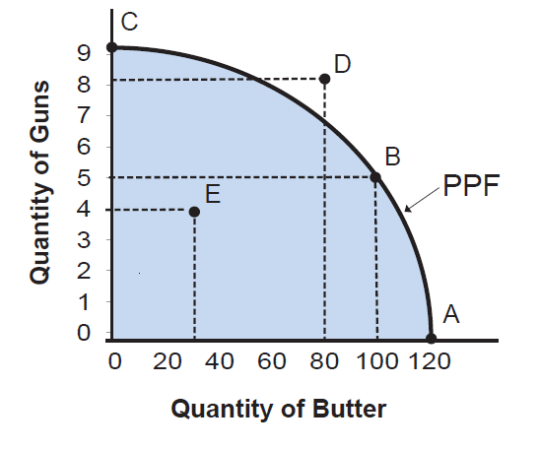
Basic Economics Problems
Lecture 1
By what methods are these commodities produced?
(How to produce ?)
What communities are being produced and in what quantities ?
(What to produce ?)
How is society’s output of goods and services divided among its members?
(For whom to produce ?)
Resource
Allocation
Labour Intensive; Capital Intensive
Distribution
of Income
Production Possibilities Curve of a Country

Slide 10
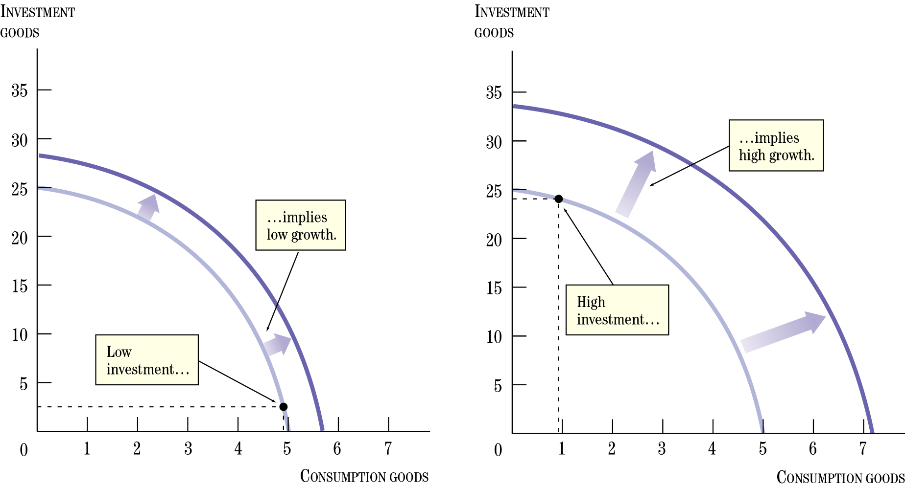
Basic Economics Problems
Lecture 1
Change in resources
Change in technology
Decrease in
available resources
Increase in
available resources
Degradation in
technology
Improvement in
technology
…implies low growth
Low investment
Production Possibilities Curve of a Country

Slide 11
Basic Economic Goals, Micro/Macro-economics
Lecture 1
Economics is the science that deals with the production and consumption of goods and services and the distribution and rendering of these for human welfare.
Microeconomics
Branch of economics that deals with the behavior of individual economic units—consumers, firms, workers, and investors—as well as the markets that these units comprise.
High level of employment
Price stability
Equitable distribution of income
Growth
Some of the above goals are interdependent, not always complementary and may be conflicting.
Eg. Any move to have a significant reduction in unemployment will lead to an increase in inflation.
Economic Goals
Macroeconomics
Branch of economics that deals with aggregate economic variables, such as the level and growth rate of national output, interest rates, unemployment, and inflation.

Slide 12
Engineering Economics
Lecture 1
Engineering is an application of science.
It is an art composed of the skill and simplicity in adopting knowledge to the uses of the humanity.
Engineering is primarily a producer activity. Essentially a physical process with the objective being the maximization of physical efficiency.
Engineering
Physical Environment
Production or Construction
Economic Environment
Engineering proposals
Wants satisfaction
Engineering Economics
Engineering Economics - deals with decisions to be taken based on need/want recognition to its satisfaction, through series of steps involving developing alternatives, evaluating them & decision-making and its efficient execution.

Slide 13
Economic System: Working
Lecture 1
An economic system is an entire set of arrangements and institutions meant for meeting the two fold objectives of a society:
– increasing the availability of resources
– ensuring the economic use
types of economic systems are based on followings:
per capita income,
prioritization of individuals to spend their resources, and
scarcity of both income and resources
Types of economy system
Capitalist Economy:
Socialist Economy
Mixed Economy

Slide 14
Capitalist Economy
Lecture 1
Capitalist Economy: characterized by free markets and the absence of government intervention in the economy.
Merits:
Self regulatory.
Process of economic growth is faster
Decides ‘what to produce’ and ‘how to produce’ in consonance with the forces of demand and supply.
Ensure a high degree of operative efficiency in the system.
Provides flexibility to adapt to the changed circumstances.
Demerits:
Capitalism generates inequalities of income and wealth.
Wide differences in economic opportunities.
Distortion in the production pattern.
Capitalism wastes its productive resources.
Production of merit goods is not profitable.
Business units produce only those goods and services which are profitable.
Loss of human values and welfare.
Increases the wastage of resources as a result of competition.

Slide 15
Socialist and Mixed Economy
Lecture 1
Socialist economy discards the use of market mechanism and replaces it with some form of regulatory authority, such as the planning commission.
It also abolishes the institutions of private property and inheritance.
Merits:
distributive justice
social security
elimination of fluctuations of economy
coordinated development
elimination of social disputes.
Demerits:
Cyclical fluctuations of national income and prices
not able to provide economic incentives and disincentives for hard work
continues to suffer from slow growth rate, poor productivity of labour and low per capita income.
Mixed economy:
– avoid the ill-effects of both capitalism and socialism
– secure the benefits of both
The selection of detailed features of a mixed economy is made with reference to the working of market mechanism, and its expected effects (both beneficial and harmful) on the society as a whole.

Slide 16
Thank you

